Slide 1
If I have my own company
Plan:
1.My dream company
2.My work until open my company
3. My respect to worker company

Slide 2
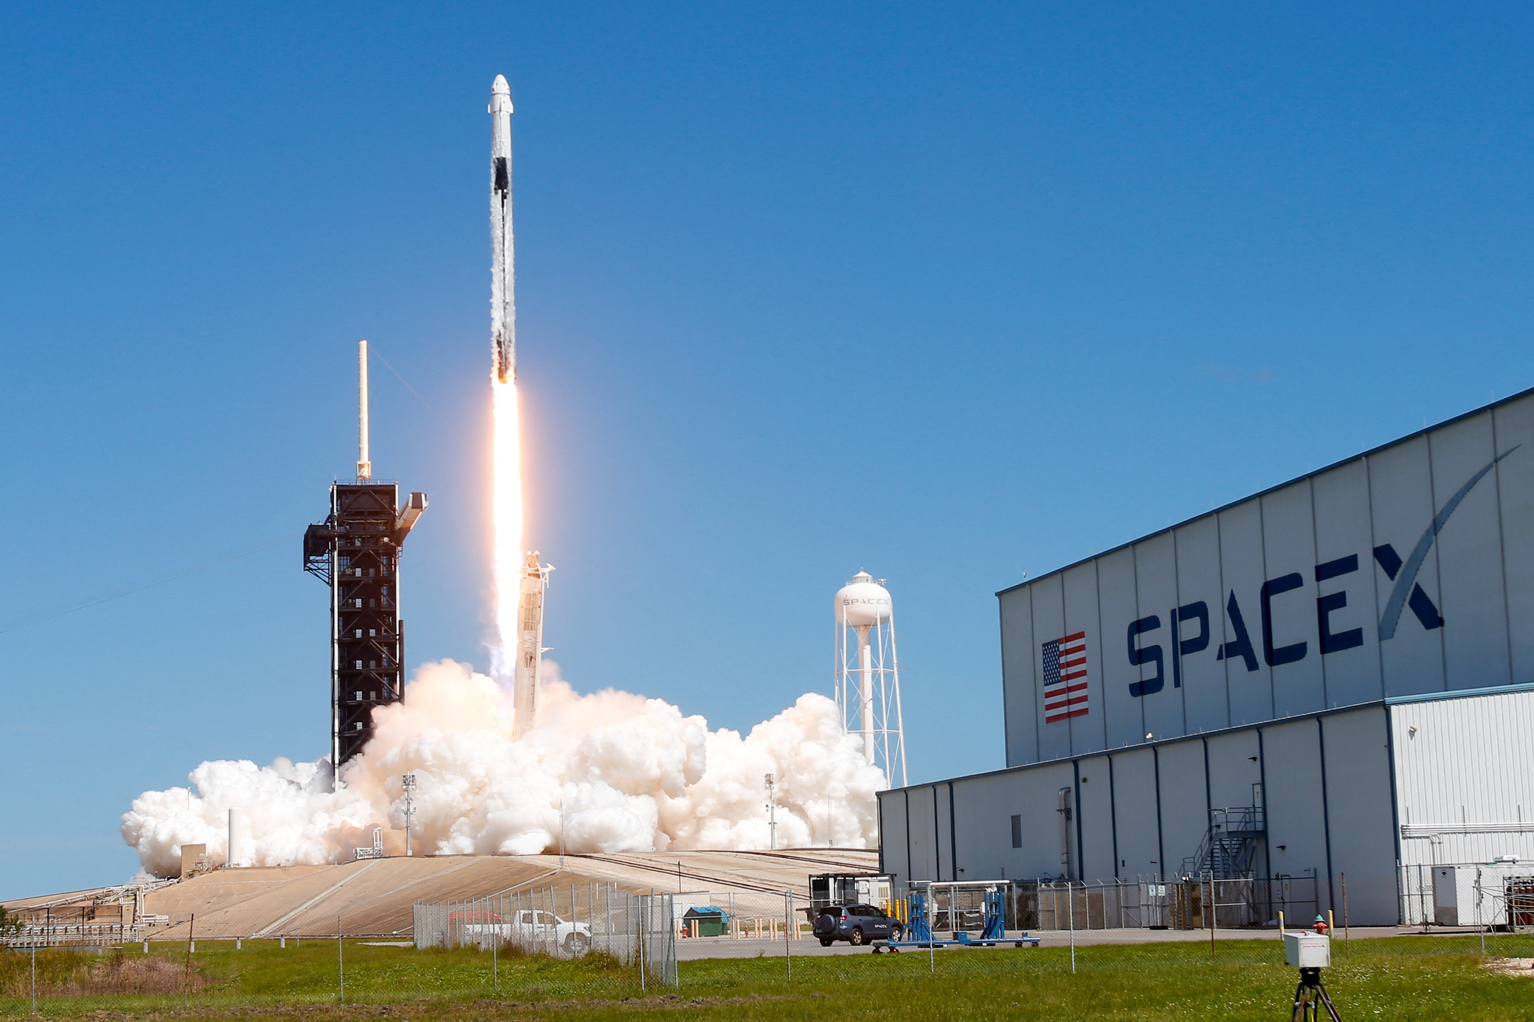
My dream company
If I have my own company, I would like to have a “Space X” company as Elon Musk. What’s the “Space X”
The first: Space X fly rackets in space and helping study space to Scientist
The second: The Space X competes with “NATO” company now
The third: It earns profit million dollars
This facts are enough to my dream company

Slide 3
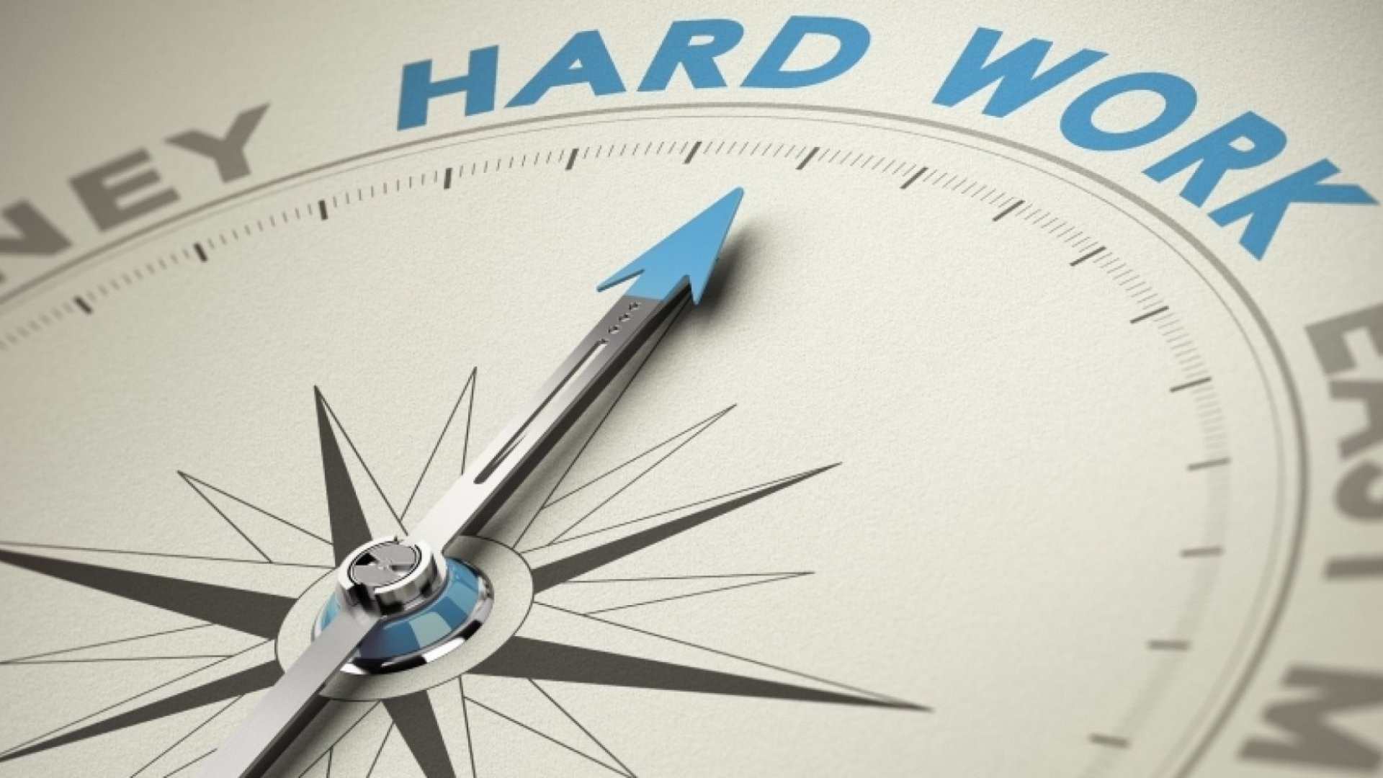
My work until open my company
This company to open should work long hours, work overtime So I get up early every day, read a lot of books, do practice a development brain and other thing. So I must be very patience and I must be enough talent.

Slide 4

My respect to worker company
If I have my own company, Workers will be work regime, meet deadlines work, have time to relax and have good working conditions because The development of company depends everybody

